Slide 1
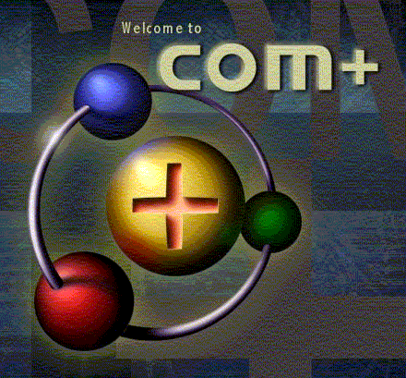
Introduction to COM+
COM+ Programming
Notes:
Page <number>
WNCOMPG-2 v1.5
Chapter 14, Introduction to COM+

Slide 2


Chapter Overview
Objectives
  Introduce COM+ and its primary services
Chapter content
  COM components in the enterprise
  Configured components and applications
  Contexts, apartments and interception
  Transactions
  Object pooling
  Security
  Queued components
  Loosely coupled events (LCEs)
Practical content
  Write a component that utilises COM+'s services
Summary
Notes:
Page <number>
WNCOMPG-2 v1.5
Chapter 14, Introduction to COM+

Slide 3


COM in the Enterprise
COM components lie at the heart of Windows DNA
  ASP / IIS provides the user interface
  COM components provide application and business logic tiers
  ADO communicates with databases
COM components therefore need to be deployed for
  Scalability
  Reliability
COM components also need access to standard services
  In particular transactions
Windows NT 4 introduced MTS
  But it was divorced from COM
Windows 2000 introduced COM+
Notes:
Page <number>
WNCOMPG-2 v1.5
Chapter 14, Introduction to COM+

Slide 4

Services Provided by COM+
Distributed Transactions
  Access to the Microsoft Distributed Transaction Coordinator (DTC)
  Compensating Resource Manager
Resource Pooling
  Objects, database connections or threads can be pooled
Queued Components
  A COM-like wrapper over Windows 2000 Message Queuing
Loosely Coupled Events
  Publish/subscribe metaphor
Just-In-Time Activation
  Keeping objects alive for as little time as possible
Role-based Security
  Simplifying access control to components based on roles
Concurrency management
Notes:
Page <number>
WNCOMPG-2 v1.5
Chapter 14, Introduction to COM+

Slide 5


How COM+ provides these services
Through a mechanism known as interception
COM components have to be configured to run in COM+
  Hence the name Configured Component
A COM component is placed inside a COM+ Application
  An evolution of the MTS package
Applications can be one of two types
  Library (in-process)
  Server (out of process, hosted in DLLHOST.EXE)
Applications and configured components use attributes
Notes:
Page <number>
WNCOMPG-2 v1.5
Chapter 14, Introduction to COM+

Slide 6
COM+ Attributes
COM+ builds upon the MTS attribute programming style
The more services handled by the platform
  The less code you have to write
Required services are specified via attributes
COM+ uses the COM+ Catalogue Manager
  And a separate configuration database
  Catalogue can be access programmatically
Component Services MMC snap-in
COM+ Catalog
Manager
Configuration
Database
Notes:
Page <number>
WNCOMPG-2 v1.5
Chapter 14, Introduction to COM+

Slide 7
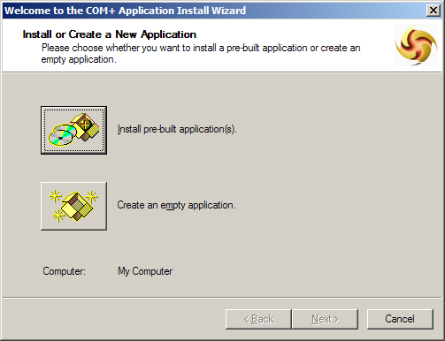
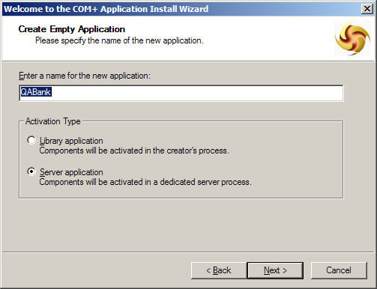
Creating a COM+ Application
Notes:
Page <number>
WNCOMPG-2 v1.5
Chapter 14, Introduction to COM+

Slide 8
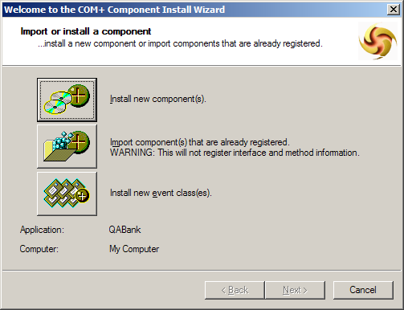
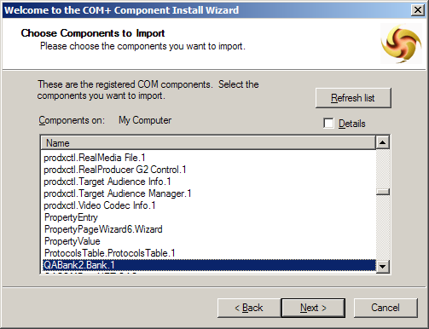
Configuring a Component
Notes:
Page <number>
WNCOMPG-2 v1.5
Chapter 14, Introduction to COM+

Slide 9
Interception
Configuration Database
Component describes requirements
CoCreateInstance checks class’s configuration
Compatible environment -
direct object reference
Client instantiates
object
Proxy
Incompatible environment -threading model OR
extended attributes conflict - proxy reference is returned
Notes:
Page <number>
WNCOMPG-2 v1.5
Chapter 14, Introduction to COM+

Slide 10
Contexts and Apartments (1)
COM+ uses contexts
  To group like-minded objects together
A process can have one or many contexts
Each context has an associated context object
  Called the Object Context
  Available via CoGetObjectContext
A default context is provided
  Where unconfigured classes will reside
Notes:
Page <number>
WNCOMPG-2 v1.5
Chapter 14, Introduction to COM+

Slide 11
Contexts and Apartments (2)
A proxy is required to cross any boundary
  Either an apartment boundary or a context boundary
COM+ introduces lightweight proxies
  When we don't need to swap threads, just contexts
  e.g. object R invoking a method on object S
Proxies perform interception services including
  Transaction Management, Serialisation, JIT Activation
Apartment X (STA)
Apartment Y (STA)
Apartment Z (MTA)
Context A
Context B
Context C
Context D
Context E
R
S
Notes:
Page <number>
WNCOMPG-2 v1.5
Chapter 14, Introduction to COM+

Slide 12
Contexts and Apartments (3)
Object references under COM+ are context relative
Marshalling is required to share object references
  CoMarshalInterface
  CoUnmarshalInterface
  The Global Interface Table
Objects can support activation in any context
  By aggregating the Free-Threaded Marshaller
Apartments still exist
  They group related contexts
  They manage the thread-context relationship
    Which threads can call into which contexts
Apartment determination algorithm unchanged
Notes:
Page <number>
WNCOMPG-2 v1.5
Chapter 14, Introduction to COM+

Slide 13
The Thread Neutral Apartment (TNA)
COM+ adds the TNA to the STA and MTA
Objects in apartments specify concurrency constraints
  Via the Synchronisation attribute
Process P1
Apartment X (STA)
Apartment Y (STA)
Apartment Z (MTA)
Context B
Context B
Context B
Context B
Apartment W (TNA)
Context E
Context F
Notes:
Page <number>
WNCOMPG-2 v1.5
Chapter 14, Introduction to COM+

Slide 14
Synchronisation and Activities
COM+ introduces the Synchronization attribute
  Controls when thread calls can be dispatched
An Activity is a collection of contexts
  That share concurrency characteristics
Activities enforce call serialisation
Activities can can span contexts/objects/processes
  Much more powerful than critical sections, mutexes etc.
Notes:
Page <number>
WNCOMPG-2 v1.5
Chapter 14, Introduction to COM+

Slide 15
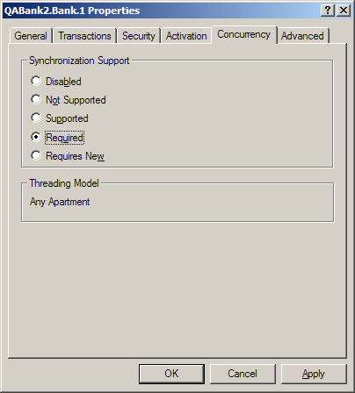

Configuring Concurrent Access
Notes:
Page <number>
WNCOMPG-2 v1.5
Chapter 14, Introduction to COM+

Slide 16
Transactions
Managing failures in distributed applications
Simplifies development, enables component re-use
Automatic and deeply integrated into the COM+ programming model
Distributed transactions across:
  SQL Server, MSMQ, COM TI, XA Resource Managers (Oracle, Informix, DB2), and more…
Transaction
Server
Client
DTC
Data
Notes:
Page <number>
WNCOMPG-2 v1.5
Chapter 14, Introduction to COM+

Slide 17
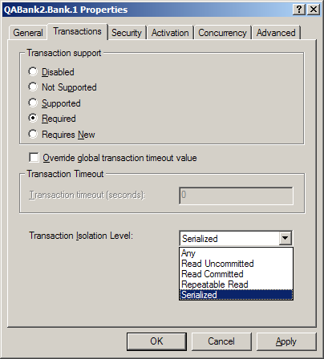
Configuring Transaction Support
Notes:
Page <number>
WNCOMPG-2 v1.5
Chapter 14, Introduction to COM+

Slide 18

Voting in a Transaction
COM+ components can vote on transaction outcome
Three flags
  The done flag
  The consistent flag
  The abort flag
IObjectContext (carried forward from MTS)
  SetComplete() - "We're good to go, Houston"
  SetAbort() - "Houston, we have a problem"
IContextState
  SetMyTransactionVote()
  SetDeactivateOnReturn()
Notes:
Page <number>
WNCOMPG-2 v1.5
Chapter 14, Introduction to COM+

Slide 19
Object Pooling
Creation time can be long for some objects
  If they are being created often, this can be a problem
Solution is to provide a pool of ready to go objects
  Minimum and maximum numbers can be controlled
  Objects can be set to die if no-one has used them for a while
Clients receive an object out of the pool
  Will block if there are no objects available
Can also use object pooling to restrict access
  Legacy component that only supports a certain number of calls
  License restrictions which might limit you to a maximum limit
Object indicates if it is safe to go back into the pool
Component must support the IObjectControl interface
Notes:
Page <number>
WNCOMPG-2 v1.5
Chapter 14, Introduction to COM+

Slide 20
Object Constructor Strings
Objects might require configurable start up information
  e.g. A DSN to connect to a database
  Don't want this information hard coded inside the component
Solution is to use an Object Constructor String
  Passed in to the object when it is made
  Set in the configured component's properties pages
Component HAS to support the IObjectConstruct interface
  E_NOINTERFACE WILL be returned on creation otherwise
Implement the method Construct(IDispatch *pDisp)
  Called once when the object is constructed
  Make sure you return a successful HRESULT on success
Notes:
Page <number>
WNCOMPG-2 v1.5
Chapter 14, Introduction to COM+

Slide 21

Just-In-Time Activation
Two phase construction
When the client calls CoCreateInstance()
  Context and object are made
When the client calls the first method
  COM+ intercepts and invokes IObjectControl::Activate()
When the client calls Release()
  COM+ intercepts the call and invokes IObjectControl::Deactivate()
Can also be used with ASAP Deactivation
  Object can indicate that it wants to be destroyed after a method
  Uses IContextState::SetDeactivateOnReturn(VARIANT_TRUE)
Notes:
Page <number>
WNCOMPG-2 v1.5
Chapter 14, Introduction to COM+

Slide 22
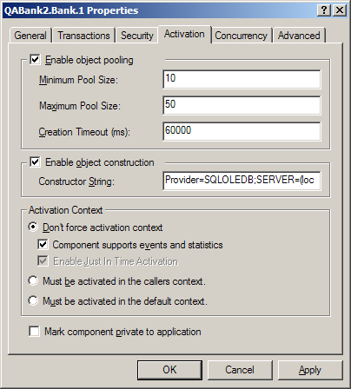
Configuring Activation Properties
Notes:
Page <number>
WNCOMPG-2 v1.5
Chapter 14, Introduction to COM+

Slide 23

COM+ Authorisation
User
Groups
Roles
Policy
Windows NT Access Token
Client
Method
Call
COM+
Executive
Principal
Request
Reference
Monitor
Resource
COM+ Application
Notes:
Page <number>
WNCOMPG-2 v1.5
Chapter 14, Introduction to COM+

Slide 24
COM+ Authentication
Roles
✓
Client
Method
Call
COM+
Executive
✓
✓
✓
DCOM
Authenticated RPC
✓
COM+ Application
SSPI
Kerberos
NTLM
SSL
Mostly transparent
done by Windows 2000
Notes:
Page <number>
WNCOMPG-2 v1.5
Chapter 14, Introduction to COM+

Slide 25
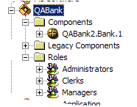
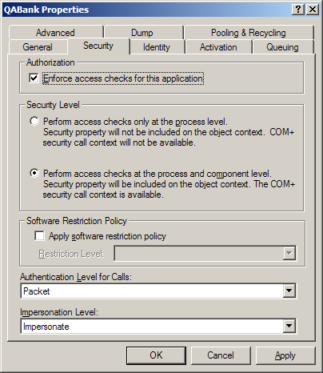
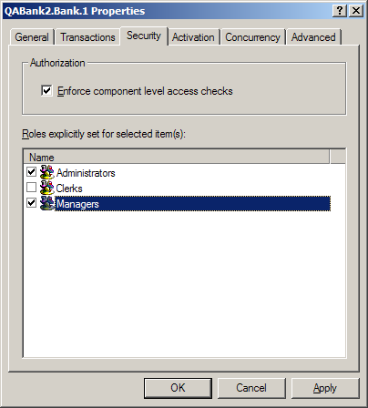
Configuring Security
Notes:
Page <number>
WNCOMPG-2 v1.5
Chapter 14, Introduction to COM+

Slide 26
Queued Components
Unification of messages and distributed components
Increase availability of distributed applications
Enable mobile scenarios
Reliable transport (exactly once delivery) using MSMQ
Transactional
Build components for connected and disconnected
Client
Recorder
Player
Server
MSMQ
Notes:
Page <number>
WNCOMPG-2 v1.5
Chapter 14, Introduction to COM+

Slide 27
Event Service
Subscription based notification for distributed apps
Notification based on subscription database
Event = component
  COM+ method invocation, but 0-n callees
  based on subscription database
Composed with Queued Components/MSMQ
  Guaranteed asynchronous delivery
Filtering on publisher and subscriber
Event
Subscriber
Publisher
Administration
Event
database
Notes:
Page <number>
WNCOMPG-2 v1.5
Chapter 14, Introduction to COM+

Slide 28
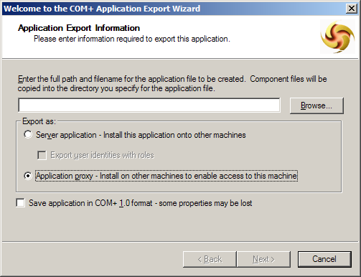
Deploying COM+ Applications
You can export you application
  Either the whole thing
  Or an application proxy
Produces an .msi Windows Installer File
Notes:
Page <number>
WNCOMPG-2 v1.5
Chapter 14, Introduction to COM+

Slide 29
Summary
COM+ is the evolution of COM and MTS into a single environment
COM+ exists on Windows 2000, XP and .NET Server
  Windows 9x/Me and NT can only act as clients
Existing COM code remains unchanged
COM+ provides many core enterprise services
  Available via configurable attributes
Simplifies the process of using transactions
At the heart of Windows DNA
  And even at the heart of .NET enterprise applications
Notes:
Page <number>
WNCOMPG-2 v1.5
Chapter 14, Introduction to COM+

